Slide 1
PowerPoint Instructions:
Check to see if you have the most up to date version of the GCP Icons, they are available at cloud.google.com/architecture/icons
Find the icon, diagram element, or diagram example that you need
Create your own GCP architectural diagram
Happy diagramming!

Slide 2
GCP Icons
v1.0

Slide 3





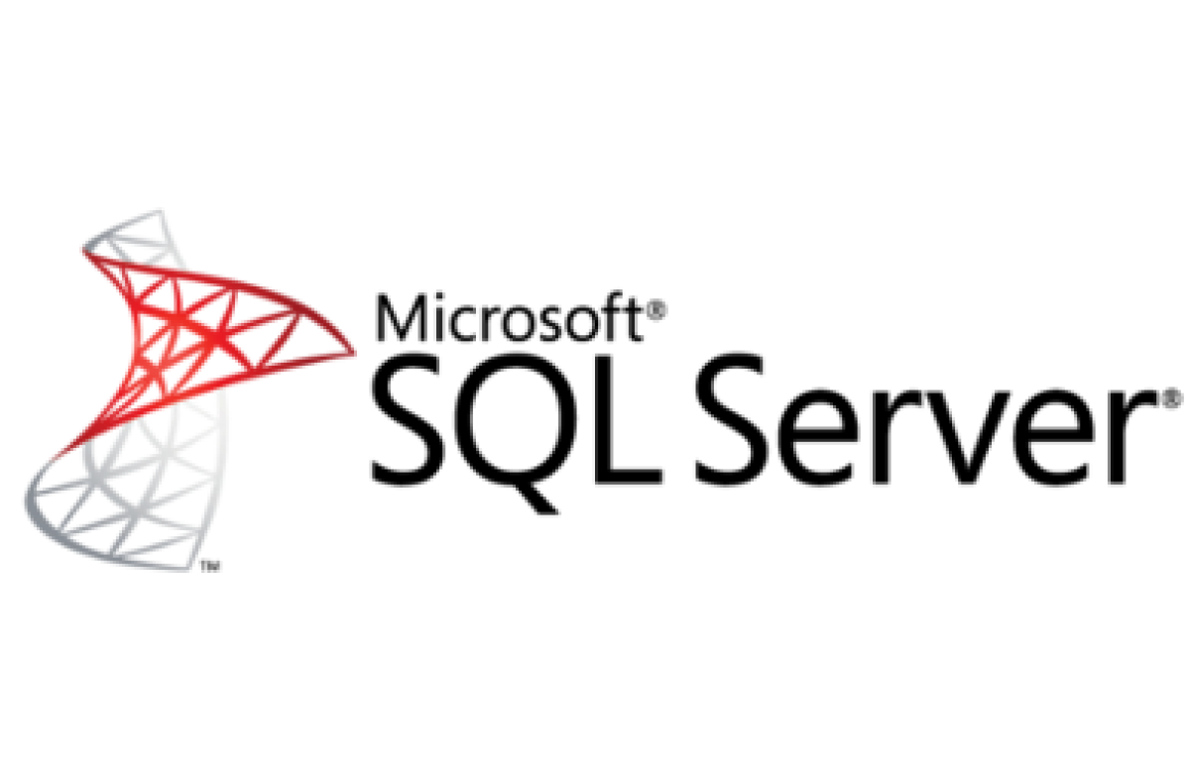
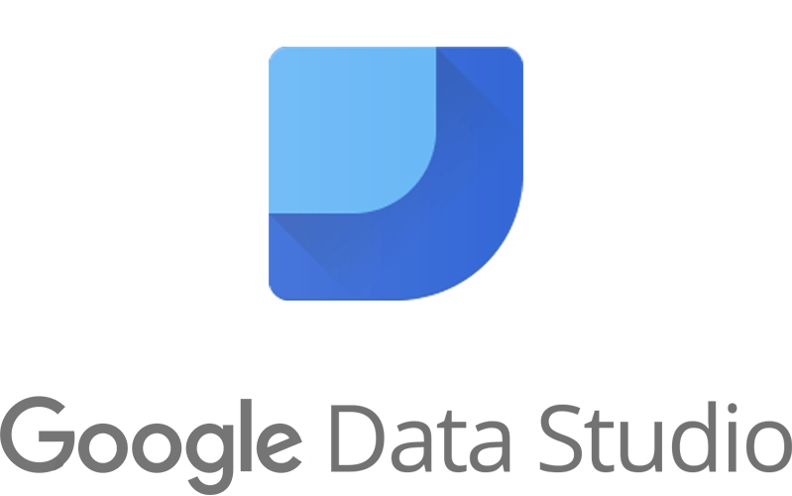



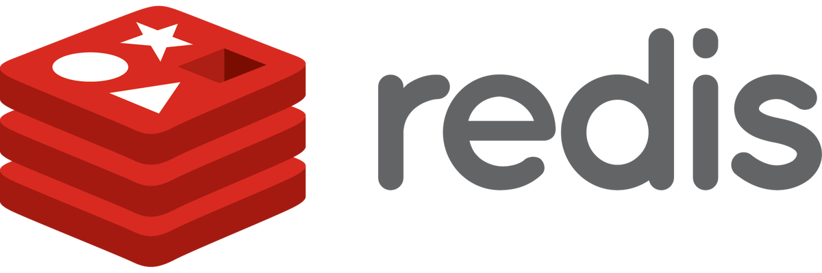



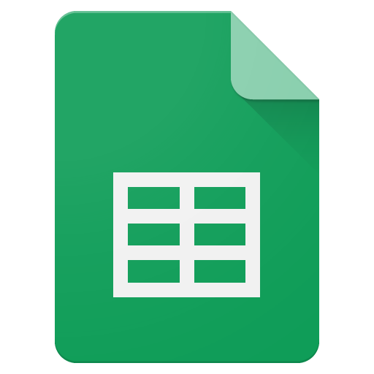





Slide 4


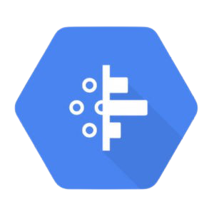



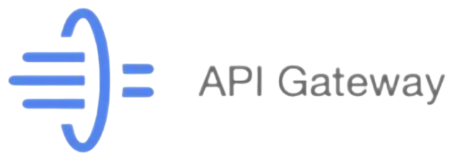
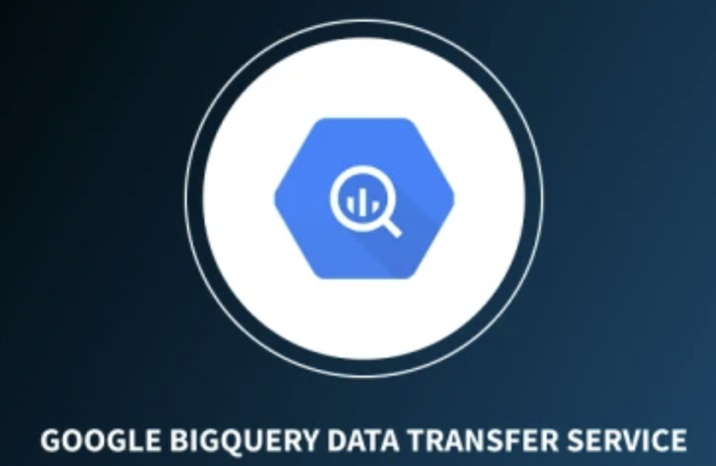
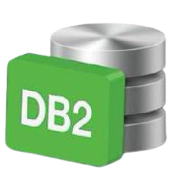


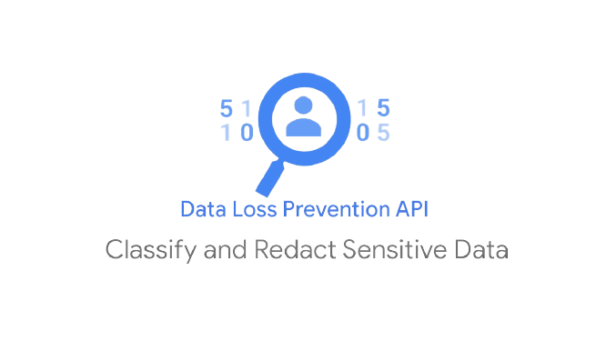

Notes:
Diagram Examples: General
General > App Engine and Cloud Endpoints
General > Compute Engine and REST or gRPC
General > Content Management
General > Digital Asset Management and Sharing
General > Firebase and Google App Engine
General > Firebase and Managed VMs
General > Firebase
General > GitLabCIonGKE
General > Hadoop on Google Cloud Platform
General > High Performance Computing
General > Real Time Bidding
General > Real Time Stream Processing IoT
General > Web Application on Google App Engine
Diagram Examples: Specific
Media > Hybrid Rendering
Media > Live Streaming
Media > Rendering
Media > Transcoding
Gaming > Backend Database
Gaming > Gaming Analytics
Gaming > Mobile Game Backend
Gaming > Real-Time AAA Games Servers
Digital Marketing > DMP Data Warehouse
Digital Marketing > Publisher side analysis
Digital Marketing > Real-Time Bidding
Internet of Things > MQTT to PubSub Broker
Internet of Things > Sensor stream ingest and processing
Financial Services > Monte Carlo Simulations
Financial Services > Time Series Analysis
Dev Test > Continuous Delivery with Spinnaker
Dev Test > Jenkins on k8s
Dev Test > Scale Testing with Kubernetes+Locust
Dev Test > UI Testing with Kubernetes
Backup and Archive > DR Cold standby server
Backup and Archive > DR Warm static site
Backup and Archive > DR with Application Replication
Backup and Archive > Hosting Filers
Websites > API Hosting
Websites > Content Hosting
Websites > Dynamic Hosting
Websites > Mobile Site Hosting
Websites > Static Hosting
Mobile > Mobile Game Backend
LifeSciences > Genomics, Secondary Analysis
LifeSciences > Patient Monitoring
LifeSciences > Variant Analysis
Retail > Beacons and Targeted Marketing
Retail > Fraud Detection
Retail > PCI
Retail > Real-Time Inventory
Retail > Recommendation Engines
Retail > Shopping Cart Analysis
Big Data > Complex Event Processing
Big Data > DMP Data Warehouse
Big Data > Log Processing
Big Data > Time Series Analysis

Slide 5


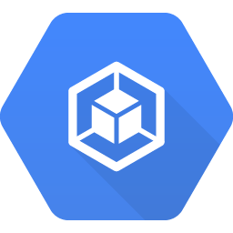


























Google Cloud Platform Icons
Compute
Identity & Security
Each Google Cloud Platform product and service have a unique Blue hexagonal icon.
Compute Engine
App Engine
Container Engine
Container Registry
Cloud Functions
Cloud IAM
Cloud Resource Manager
Cloud Security Scanner
Cloud Platform Security
Networking
Big Data
Cloud Virtual Network
Cloud Load Balancing
Cloud CDN
Cloud Interconnect
Cloud DNS
BigQuery
Cloud Dataflow
Cloud Dataproc
Cloud Datalab
Cloud Pub/Sub
Genomics
Storage and Databases
Machine Learning
Cloud Storage
Cloud Bigtable
Cloud Datastore
Cloud SQL
Persistent Disk
Cloud Machine Learning
Vision API
Speech API
Natural Language API
Translation API
Jobs API

Slide 6
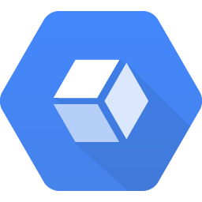







Google Cloud Platform Icons
Management Tools
Stackdriver
Monitoring
Logging
Error Reporting
Trace
Debugger
Deployment Manager
Cloud Endpoints
Cloud Console
Cloud Shell
Cloud Mobile App
Billing App
Cloud APIs
Developer Tools
GCP products and services without a unique icon utilize a generic hexagonal icon.
Cloud SDK
Deployment Manager
Cloud Source Repositories
Cloud Tools for Android Studio
Cloud Tools for IntelliJ
Cloud Tools for PowerShell
Cloud Tools for Visual Studio
Google Plug-in for Eclipse
Cloud Test Lab

Slide 7
Diagram Elements

Slide 8




Diagram Elements: Overview
8
Architecture: Backup and Archive > DR Cold standby server
3
The call-outs below identify the various elements found in a diagram.
1 User Cards 2 User Paths 3 Project/Platform Zone 4 Product Card 5 Zone grouping 6 Expanded Product Card 7 Service Card 8 Title bar (Optional) 9 Footer (Optional)
1
5
4
Instance Group
6
7
2
Cloud DNS
Cloud Load Balancing
Serving Instance Compute Engine
Persistent Disk Snapshot
Multiple Instances
Instance Group
Heartbeat and Snapshot System Compute Engine
Multiple Instances
9

Slide 9


Diagram Elements: User Cards and User Paths
Grey icons represent user or device input.
User elements are located on the left side of the diagram, where the flow originates. A path connects these elements to Google Cloud Platform elements. A name can be used to clarify the user or alternate input method.
User and alternate input icons are 72x72px with a black (#000000) fill at 54% opacity.
Generic User
Specific User
Phone User
Alternate Input
User Name
Mobile Devices
Gateway
Primary Path
2pt | Google Blue | #4284F3
Optional Primary Path
2pt Dashed | Google Blue | #4284F3
Secondary Path
2pt | 38% Black | #9E9E9E
Optional Secondary Path
2pt Dashed | 38% Black | #9E9E9E
Success Status
2pt | Google Green | #34A853
Failure Status
2pt | Google Red | #EA4335

Slide 10







Diagram Elements: Product and Service Cards
Product Card
Expanded Product Card
Service Card
Product and Service information is displayed using Material Design cards.
Product Cards can be single or grouped. Product Cards can display a functional name above the product name for additional clarity.
Expanded Product Cards allow the use of icons and text to identify attributes of the product.
Service cards use a circular icon frame and text wrapped to decrease card width.
Compute Engine
Batch Processing Compute Engine
Local Compute
Multiple Instances
Virtual File System
Analytics Backend Compute Engine
Compute Engine
10GB PD
1
1
Push Notification Service
Analytics Backend Compute Engine
Analytics Backend Compute Engine

Slide 11
Diagram Elements: Zones and Nesting
User 1 (Default) #FFFFFF
System 1 #F1F8E9
Project Zone / Cloud Service Provider #F6F6F6
Zones define project areas and groups within project areas.
Use zones to clarify diagram structure and flow. The user area can also contain zones to clarify user pathways.
All zones have 2px rounded corners.
Zones do not have shadows.
Logical Grouping of Services / Instances #E3F2FD
Region #ECEFF1
Infrastructure System 2 #F3E5F5
External SaaS Providers #FFEBEE
Zone #FFF3E0
Zone #FFF3E0
SubNetwork #EDE7F6
Firewall #FBE9E7
External Data Sources #FFF8E1
Instance Group #F9FBE7
Kubernetes cluster #FCE4EC
colo / dc / on premises #EFEBE9
External infrastructure 3rd party #E0F2F1
Replica Pool #E0F7FA
pod #E8F5E9
External infrastructure 1st party #E1F5FE
Account #E8EAF6
Optional Component 2pt dashed line #4284F3

Slide 12



Diagram Elements: Zones and Nesting - Specifications
1
Constrained Devices Non-TCP e.g. BLE
2
Standard Devices HTTPS
User Zones:
1 16px padding (all sides)
2 Zone Heading - Roboto Med 16px type / 24px line-height #000000 | 38% opacity
3 Zone Subhead - Roboto Reg 12px type / 16px line-height #000000 | 38% opacity
4 Icon Title - Roboto Reg 12px | #000000 | 87% opacity
5 Icons #000000 | 54% Opacity centered in zones
Storage
3
Cloud Storage
Cloud Datastore
Ingest
Pipelines
Cloud Bigtable
Application & Presentation
Cloud Pub/Sub
Cloud Dataflow
App Engine
Gateway
Monitoring
Analytics
Container Engine
Cloud Dataflow
4
Logging
Compute Engine
BigQuery
Cloud Dataproc
5
Cloud Datalab

Slide 13
Diagram Elements: Zones and Nesting - Specifications
1
2
Constrained Devices Non-TCP e.g. BLE
Standard Devices HTTPS
Storage
Project Zone:
1 16px padding top |24px padding right, bottom, left
2 Project Zone - Heading (Optional) Roboto Med 16px type / 24px line-height #000000 | 87% opacity
3 Zone Level 1 - Heading Roboto Med 16px type / 24px line-height #000000 | 38% opacity 8px pad top, 16px Pad left
4 Zone Level 1 - Cards 8px padding top, right, bottom, left and between cards
Cloud Storage
3
Cloud Datastore
Ingest
Pipelines
Cloud Bigtable
Application & Presentation
Cloud Pub/Sub
Cloud Dataflow
App Engine
Gateway
Monitoring
Analytics
Container Engine
Cloud Dataflow
Logging
Compute Engine
BigQuery
4
Cloud Dataproc
Cloud Datalab

Slide 14
Diagram Elements: Zones and Nesting - Specifications
1
Project Zone Exceptions:
1 Stacked cards need additional padding due to shadow width.
+ 8px padding right, bottom and, left
ZONE 1
ZONE 1
Batch Processing Compute Engine
Analytics Backend Compute Engine
+8px
+8px
Multiple Instances
+8px
Stacked card with additional padding
Standard card with normal padding

Slide 15
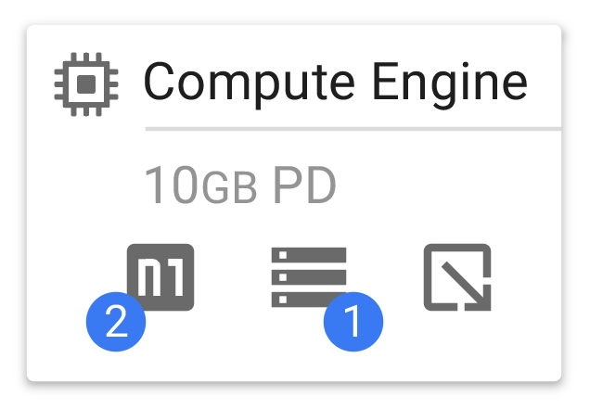
Diagram Elements: Expanded Product Card - Specifications
Disks
Call out disk size and type used on a Product Card.
When using the Expanded Product Card you can identify the number of disks, the total storage capacity, and the type of disks being used.
Disk options PD - Persistent Disk PD-SSD - Persistent SSD Disk Local SSD - Local SSD Disk
Disk icons, like other icons, are black (#000000) at 54% opacity
Disk size and type
Disk icon
Number of disks
Instance w/1 Persistent Disk

Slide 16
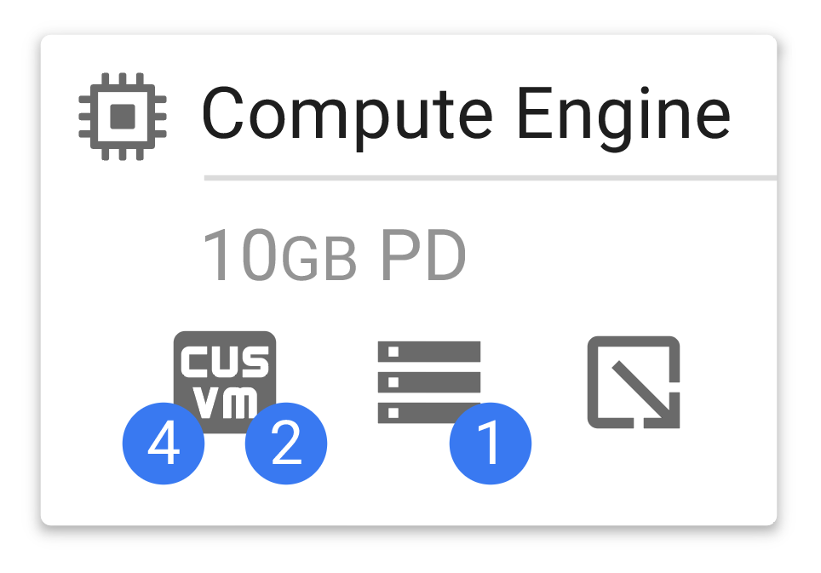





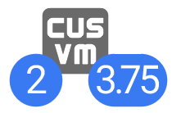
Diagram Elements: Expanded Product Card - Specifications
Machine Type
Six different machine types can be defined by a unique icon and identifiers for “GB of RAM per core” and “number of cores”.
Machine Type Options Standard machine Shared-core machine (F1) Shared-core machine (G1) High-CPU machine High-memory machine Custom Virtual Machine
Standard machine
High-CPU machine
Shared-core machine
High-memory machine
Number of cores
GB of RAM per core
Machine type
Custom Virtual Machine
Shared-core machine
Longer RAM value example
Instance w/4GB RAM for each core

Slide 17
Diagram Elements: Title and Footer Bars
Title Bar
An optional Title and Footer bar can be added to diagrams if needed.
The Title and Footer bars create a polished and complete look when used with a diagram.
Architecture: App Engine and Cloud Endpoints
Footer Bar

Slide 18
Material Icons from Google

Slide 19

Icons and Material Design
Material Design icons are simple, modern, friendly, and sometimes quirky. Each icon is reduced to its minimal form. The designs ensure readability and clarity even at small sizes.
Use these icons to create specific User and Device Cards or Service Cards while maintaining a consistent visual look.
Material icons can be searched and downloaded directly from material.io/icons/
Sample of Material icons

Slide 20
Elements for Slides & PPT

Slide 21


















User and Device Cards
One Line
Two Line

Slide 22


















Service Cards
Gateway
Task Queues
Application System(s)
Network Load Balancer
Blank One Line
Memcache
Image Services
Virtual File System
Blank One Line
Google Network W/ Edge Cache
Logs API
Dedicated Game Server
CDN Interconnect
Blank Two & Three Line
Push Notification Service
Cluster
Frontend Platform Services
Scheduled Tasks
Blank Two & Three Line
NAT
Google Edge POP
HTTPS Load Balancer
Squid Proxy
External Payment Form
Persistent Disk Snapshot
Bucket
Internal Payment Authorization
Persistent Disk
Service Discovery
VPN Gateway

Slide 23
Zones
User 1 (Default) #FFFFFF
System 1 #F1F8E9
Project Zone / Cloud Service Provider #F6F6F6
Logical Grouping of Services / Instances #E3F2FD
Region #ECEFF1
Infrastructure System 2 #F3E5F5
External SaaS Providers #FFEBEE
Zone #FFF3E0
Zone #FFF3E0
SubNetwork #EDE7F6
Firewall #FBE9E7
External Data Sources #FFF8E1
Instance Group #F9FBE7
Kubernetes cluster #FCE4EC
colo / dc / on premises #EFEBE9
External infrastructure 3rd party #E0F2F1
Replica Pool #E0F7FA
pod #E8F5E9
External infrastructure 1st party #E1F5FE
Account #E8EAF6
Optional Component 2pt dashed line #4284F3

Slide 24
Product Cards
Compute
Storage and Databases
Compute Engine
Name Compute Engine
Name Compute Engine
Cloud Storage
Name Cloud Storage
Name Cloud Storage
App Engine
Name App Engine
Name App Engine
Cloud Bigtable
Name Cloud Bigtable
Name Cloud Bigtable
Container Engine
Name Container Engine
Name Container Engine
Cloud Datastore
Name Cloud Datastore
Name Cloud Datastore
Container Registry
Name Container Registry
Name Container Registry
Cloud SQL
Name Cloud SQL
Name Cloud SQL
Cloud Functions
Name Cloud Functions
Name Cloud Functions
Persistent Disk
Name Persistent Disk
Name Persistent Disk

Slide 25
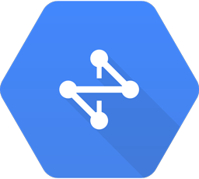
Product Cards
Networking
Big Data
Cloud Virtual Network
Name Cloud Virtual Network
Name Cloud Virtual Network
BigQuery
Name BigQuery
Name BigQuery
Cloud Load Balancing
Name Cloud Load Balancing
Name Cloud Load Balancing
Cloud Dataflow
Name Cloud Dataflow
Name Cloud Dataflow
Cloud CDN
Name Cloud CDN
Name Cloud CDN
Cloud Dataproc
Name Cloud Dataproc
Name Cloud Dataproc
Cloud Interconnect
Name Cloud Interconnect
Name Cloud Interconnect
Cloud Datalab
Name Cloud Datalab
Name Cloud Datalab
Cloud DNS
Name Cloud DNS
Name Cloud DNS
Cloud Pub/Sub
Name Cloud Pub/Sub
Name Cloud Pub/Sub
Cloud Network
Name Cloud Network
Name Cloud Network
Genomics
Name Genomics
Name Genomics

Slide 26
Product Cards
Machine Learning
Identity & Security
Cloud Machine Learning
Name Cloud Machine Learning
Name Cloud Machine Learning
Cloud IAM
Name Cloud IAM
Name Cloud IAM
Vision API
Name Vision API
Name Vision API
Cloud Resource Manager
Name Cloud Resource Manager
Name Cloud Resource Manager
Speech API
Name Speech API
Name Speech API
Cloud Security Scanner
Name Cloud Security Scanner
Natural Language API
Name Natural Language API
Name Natural Language API
Name Cloud Security Scanner
Translation API
Name Translation API
Name Translation API
Cloud Platform Security
Name Cloud Platform Security
Jobs API
Name Jobs API
Name Jobs API
Name Cloud Platform Security

Slide 27
Product Cards
Management Tools
Stackdriver
Name Stackdriver
Name Stackdriver
Debugger
Name Debugger
Name Debugger
Monitoring
Name Monitoring
Name Monitoring
Deployment Manager
Name Deployment Manager
Name Deployment Manager
Logging
Name Logging
Name Logging
Cloud Console
Name Cloud Console
Name Cloud Console
Error Reporting
Name Error Reporting
Name Error Reporting
Cloud Shell
Name Cloud Shell
Name Cloud Shell
Trace
Name Trace
Name Trace
Cloud Mobile App
Name Cloud Mobile App
Name Cloud Mobile App
Cloud Endpoints
Name Cloud Endpoints
Name Cloud Endpoints
Billing App
Name Billing App
Name Billing App
Cloud APIs
Name Cloud APIs
Name Cloud APIs

Slide 28
Product Cards
Developer Tools
Cloud SDK
Name Cloud SDK
Name Cloud SDK
Cloud Tools for Visual Studio
Name Cloud Tools for Visual Studio
Name Deployment Manager
Name Cloud Tools for Visual Studio
Deployment Manager
Name Deployment Manager
Cloud Source Repositories
Name Cloud Source Repositories
Name Cloud Source Repositories
Google Plugin for Eclipse
Name Google Plugin for Eclipse
Cloud Tools for Android Studio
Name Cloud Tools for Android Studio
Name Cloud Tools for Android Studio
Name Google Plugin for Eclipse
Cloud Tools for IntelliJ
Name Cloud Tools for IntelliJ
Name Cloud Tools for IntelliJ
Cloud Test Lab
Name Cloud Test Lab
Name Cloud Test Lab
Cloud Tools for PowerShell
Name Cloud Tools for PowerShell
Name Cloud Tools for PowerShell

Slide 29




Expanded Product Cards
Name Compute Engine
Name Compute Engine
Name BigQuery
Name BigQuery
App Engine
10GB PD
Attribute Name
Attribute Name
Attribute Name
Attribute Name
1
1
1
Name App Engine
Name App Engine
Name Cloud Dataflow
Name Cloud Dataflow
Cloud Dataflow
10GB PD
Attribute Name
Attribute Name
Attribute Name
Attribute Name
1
1
1
Name Container Engine
Name Container Engine
Name Cloud Storage
Name Cloud Storage
Container Engine
10GB PD
Attribute Name
Attribute Name
Attribute Name
Attribute Name
1
1
1
Name Cloud Bigtable
Name Cloud Bigtable
Name Cloud Pub/Sub
Name Cloud Pub/Sub
Cloud Dataproc
10GB PD
Attribute Name
Attribute Name
Attribute Name
Attribute Name
1
1
1
Name Cloud SQL
Name Cloud SQL
Compute Engine
10GB PD
Attribute Name
Attribute Name
1
1
1

Slide 30
Title bar, Footer bar, Project Zone, Notes, Markers, and Legend
Architecture: App Engine and Cloud Endpoints
Use this note to call out or clarify parts of a diagram
1
2
3
4
5
6
7
1 Commit code
2 Detect code change
3 Build immutable image
4 Launch test instance from image
5 Run tests
6 Perform rolling update of image to autoscaler
Markers to be use with the legend to the right

Slide 31
Diagram Examples: General

Slide 32
General > App Engine and Cloud Endpoints
Architecture: General > App Engine and Cloud Endpoints
iOS
Endpoint Clients
Android
Mobile Backend API Cloud Endpoints
App Engine
Web

Slide 33
General > Compute Engine and REST or gRPC
Architecture: General > Compute Engine and REST of gRPC
iOS
Android
Mobile Services REST API Compute Engine
Web

Slide 34
General > Content Management
Architecture: General > Content Management
Cloud DNS
ZONE A
Content Server Compute Engine
Static Content Cloud Storage
Autoscaling
Cloud Load Balancing
ZONE B
Dynamic Content Cloud SQL
Content Server Compute Engine
Publisher
Autoscaling

Slide 35
General > Digital Asset Management and Sharing
Architecture: General > Digital Asset Management and Sharing
Task Queues
Asset Mgmt & Sharing App Engine
Meta Data & Workflow Cloud SQL
Media Processing Compute Engine
Cloud Load Balancing
Authentication
Meta Data & Workflow Cloud Datastore
Autoscaling
Autoscaling
Push Meta Data Navigation Search Share
Upload / Download Media
Cloud Network W/ Edge Cache
Media Storage Cloud Storage

Slide 36

General > Firebase and Google App Engine
Architecture: General > Firebase and Google App Engine
iOS
App Engine
Process the Data
Synchronize Across Devices
Android
Update Data
Firebase
Web

Slide 37
General > Firebase and Managed VMs
Architecture: General > Firebase and Managed VMs
Runs Your Service in Docker Containers
iOS
App Engine
Docker Container Engine
Process the Data
Android
Update Data
Firebase
Synchronize Across Devices
Web

Slide 38
General > Firebase
Architecture: General > Firebase
iOS
Synchronize Data Across Devices
Android
Update Data
Firebase
Web

Slide 39
General > GitLabCIonGKE
Architecture: General > GitLabClonGKE
Git Repos Compute Engine
Backups
Bucket
PostgreSQL
PG DATA Compute Engine
Compute Engine
10GB PD
NGINX Plus
GitLab Rails
1
CI Runners
Cloud Load Balancing
Compute Engine
Compute Engine
Container Engine
10GB PD
10GB PD
2
1
1
Redis
Compute Engine
Compute Engine
Compute Engine
10GB PD
10GB PD
10GB PD
4
1
4
1
4
1

Slide 40
General > Hadoop on Google Cloud Platform
Architecture: General > App Engine and Cloud Endpoints
Google Cloud Storage Connector for Hadoop
Input Data Cloud Storage
Hadoop Master Compute Engine
Map Reduce Task Compute Engine
Multiple Instances
Output Data Cloud Storage
Google Cloud Storage Connector for Hadoop

Slide 41
General > High Performance Computing
Architecture: General > High Performance Computing
Optional File System
HPC Head Node Compute Engine
Compute Node Compute Engine
File System Compute Engine
Input Data Cloud Storage
Multiple Instances
Multiple Instances
Output Data Cloud Storage

Slide 42

General > Real Time Bidding
Architecture: General > Real Time Bidding
Ads & Images Cloud Storage
Bidding App Compute Engine
Map Reduce Compute Engine
Ads & Images Cloud SQL
Autoscaling
Autoscaling
DoubleClick Ad Exchange
Cloud Load Balancing
Pixel Server Compute Engine
Modeling & Analytics App Engine
Autoscaling
Prediction API
Campaign Client
Campaign Server App Engine
Campaign & Results Cloud SQL
BigQuery

Slide 43
General > Real Time Stream Processing IoT
Architecture: General > Real Time Stream Processing - Internet of Things
Constrained Devices Non-TCP e.g. BLE
Standard Devices HTTPS
Storage
Cloud Storage
Cloud Datastore
Ingest
Pipelines
Cloud Bigtable
Application & Presentation
Cloud Pub/Sub
Cloud Dataflow
App Engine
Gateway
Monitoring
Analytics
Container Engine
Cloud Dataflow
Logging
Compute Engine
BigQuery
Cloud Dataproc
Cloud Datalab

Slide 44
General > Web Application on Google App Engine
Architecture: General > Web Application on Google App Engine
Static Content Cloud Storage
Dynamic Content Cloud SQL
Batch App App Engine
Cloud Load Balancing
Front End App App Engine
Dynamic Content Cloud Datastore
Autoscaling
Autoscaling
Cloud DNS
Memcache
Task Queues

Slide 45
Diagram Examples: Specific

Slide 46

Media > Hybrid Rendering
Architecture: Media > Hybrid Rendering
On-Premises “Render Farm”
Local Compute
Gateway
Google Cloud Interconnect & VPN
Avere Physical Appliance
Gateway
Avere Virtual Edge Filter
Local Storage
Compute Engine
Cloud Storage

Slide 47

Media > Live Streaming
Architecture: Media > Live Streaming
Browser Client
Live Event
Recording
Encoding
Mobile / Tablet Client
RTPM / RTSP
Streaming Server Compute Engine
CDN Interconnect
Fastly CDN
Recording Module
Segment Storage Cloud Storage
Streaming Player

Slide 48

Media > Rendering
Architecture: Media > Rendering
On-Premises “Render Farm”
Local Compute
Gateway
Google Cloud Interconnect & VPN
Gateway
Virtual File System
Local Storage
NFS & SMB
Compute Engine
Cloud Storage

Slide 49
Media > Transcoding
Architecture: Media > Transcoding
Source Files Cloud Storage
Queuing / Scheduler
Launch VMs
Copy Files Locally
ffmpeg command
Output is multiple codecs, resolutions, and bit rates
DRM on VM
If DRM is Windows based, a separate VM can be used
Copy Files Cloud Storage
Shutdown VM
Quality Assurance
Ready for Streaming

Slide 50
Gaming > Backend Database
Architecture: Gaming > Backend Database
Game Database
Frontend Platform Services
Cloud SQL
Clients
Analytics Backend BigQuery
or
Dedicated Game Server
Cloud Bigtable

Slide 51
Gaming > Gaming Analytics
Architecture: Gaming > Gaming Analytics
Streaming
Real-Time Events Multiple Platforms
Authentication App Engine
Async Messaging Cloud Pub/Sub
Data Exploration Cloud Datalab
Report & Share Business Analysis
Data Processing Cloud Dataflow
Analytics Engine BigQuery
Batch
Gaming Logs Batch Load
Log Data Cloud Storage

Slide 52



Gaming > Mobile Game Backend
Architecture: Gaming > Mobile Game Backend
Apple Push Notification Service
Sockets API
Google Cloud Messaging
Scheduled Tasks
iOS
Logs API
Mobile Game Backend App Engine
Batch Processing Compute Engine
Cloud Endpoints
Task Queues
Cloud Endpoint Clients
Multiple Instances
Android
Multiple Instances
Optional Components
AdMob
Memcache
Cloud Datastore
Image Services
Cloud Storage
BigQuery
Google Play Game Services

Slide 53
Gaming > Real-Time AAA Games Servers
Architecture: Gaming > Real-Time AAA Games Servers
Frontend Platform Services
Analytics Backend BigQuery
Service Discovery
Dedicated Game Servers
Game Database
Clients
Virtual Machines Compute Engine
Cloud SQL
Multiple Instances
or
Cloud Bigtable
or
Kubernetes Cluster Container Engine
Multiple Instances

Slide 54


Digital Marketing > DMP Data Warehouse
Architecture: Digital Marketing > DMP Data Warehouse
DoubleClick Campaign Manager
Relevant Users Cloud Storage
Customer Lists Logic
Export Ad Data Cloud Storage
Id matching Cloud Dataflow
Google Analytics
Reference table BigQuery
Marketing List

Slide 55


Digital Marketing > Publisher side analysis
Presentation Layer
Analysis Layer
Processing & Analysis Layer
Storage Layer
CMS App Engine
BI Interface Data Studio 360
Managed Data Warehouse BigQuery
Ingestion Layer
or
E-commerce Platform App Engine
Image Analysis Vision API
Managed Data Warehouse Cloud SQL
Experiences
TensorFlow
Container Infra GKE/Kubernetes
Columnar/NoSQL Cloud Bigtable
or
Web/Mobile Application App Engine
Cloud Dataproc
Production Storage Cloud Storage
ETL Dataflow
Archival Storage Cloud Storage Nearline
Ingestion Layer
Data Sources
Cloud Dataflow
Cloud Pub/Sub
Batch Processing
1st Party Cluster
DoubleClick
Real-time Analytics
2nd Party Cluster
Cloud Dataproc
BigQuery
Compute Engine
3rd Party Cluster

Slide 56
Digital Marketing > Real-Time Bidding
us-east
europe-west
us-central
asia-east
Data Proxy Servers Compute Engine
Data Proxy Servers Compute Engine
Ad Exchange
Bid Servers Compute Engine
Database Bid Compute Engine
Database Bid Compute Engine
Cloud Load Balancing
Pixel Servers Compute Engine
Database User Compute Engine
Database User Compute Engine
Analytics
Campaign management

Slide 57
Internet of Things > MQTT to PubSub Broker
Architecture: Internet of Things > MQTT to PubSub Broker
IoT Application App Engine
Autoscaled Broker Tier Custom MQTT <-> Cloud Pub/Sub broker
MQTT Devices
Cloud Load Balancing
MQTT Broker Compute Engine
IoT Topic Cloud Pub/Sub
RabbitMQ™
Stream Analytics Cloud Dataflow
IoT Warehouse BigQuery

Slide 58
Internet of Things > Sensor stream ingest and processing
Architecture: Internet of Things > Sensor stream ingest and processing
Constrained Devices Non-TCP e.g. BLE
Standard Devices HTTPS
Storage
Cloud Storage
Cloud Datastore
Ingest
Pipelines
Cloud Bigtable
Application & Presentation
Cloud Pub/Sub
Cloud Dataflow
App Engine
Gateway
Monitoring
Analytics
Container Engine
Cloud Dataflow
Logging
Compute Engine
BigQuery
Cloud Dataproc
Cloud Datalab

Slide 59
Financial Services > Monte Carlo Simulations
Architecture: Financial Services > Monte Carlo Simulations
Data
Processing
Storage/Analysis BigQuery
Hadoop/Spark Cloud Dataproc
Storage Cloud Bigtable
Dataflow/Beam Cloud Dataflow
Visualization Cloud Datalab
Storage Cloud Storage
Bespoke Apps Compute Engine

Slide 60
Financial Services > Time Series Analysis
Architecture: Financial Services > Time Series Analysis
Batch
Storage BigQuery
ML Cloud ML
Time Series Files Cloud Storage
Time Series Processing Cloud Dataflow
Storage Cloud Bigtable
Processing Cloud Dataproc
Streaming
Time Series Streaming Cloud Pub/Sub
Storage Cloud Storage
Analysis Cloud Datalab

Slide 61
Dev Test > Continuous Delivery with Spinnaker
Development Team
us-east1-d
Code Repository DevTools
Test Instances Compute Engine
1
2
Build Artifact
Spinnaker Compute Engine
Prod Instances Compute Engine
5
Users
3
Autoscaler
Cloud Image Compute Engine
Cloud Load Balancing
4
Build Artifact
6
us-central1-f
Prod Instances Compute Engine
Autoscaler
1 Commit code
2 Detect code change
3 Build immutable image
4 Launch test instance from image
5 Run tests
6 Perform rolling update of image to autoscaler

Slide 62
Dev Test > Jenkins on k8s
End Users
Developers
Production Namespace
Code Repository DevTools
Frontend ReplicationController
Cloud Load Balancing
1
2
Jenkins Namespace
Backend ReplicationController
Jenkins Master Pod
7
3
Staging Namespace
Ops & Quality
Jenkins Slaves ReplicationController
Frontend ReplicationController
4
6
Docker Images Container Registry
Backend ReplicationController
5
1 Commit Code
2 Code Enters CD Pipeline
3 Test/Build Job Submitted to Slave
4 Push Docker images
5 Images Deployed to Staging
6 Operational and Functional Testing
7 Images Deployed to Production

Slide 63
Dev Test > Scale Testing with Kubernetes+Locust
Architecture: Dev Test > Scale Testing with Kubernetes+Locust
Load Testing Namespace
Application Under Test Namespace
Frontend Container Engine
Test Operator
4
6
Locust Master Container Engine
2
Locust Workers Container Engine
Frontend Service
Backend Service
3
1
5
Backend Container Engine
1 Tester starts test
2 Master starts load
3 Workers send request to FE service
4 FE pods talk to BE service
5 Worker report results
6 Tester views results

Slide 64
Dev Test > UI Testing with Kubernetes
Architecture: Dev Test > UI Testing with Kubernetes
Selenium Namespace
Web App Namespace
Chrome Nodes Container Engine
UI Servers Container Engine
Tester
Replication Controller
Replication Controller
Selenium Hub Container Engine
Hub Service
Frontend Service
Backend Service
Replication Controller
Firefox Nodes Container Engine
Backend Servers Container Engine
Replication Controller
Replication Controller

Slide 65
Backup and Archive > DR Cold standby server
Architecture: Backup and Archive > DR Cold standby server
Instance Group
Cloud DNS
Cloud Load Balancing
Serving Instance Compute Engine
Persistent Disk Snapshot
Multiple Instances
Instance Group
Heartbeat and Snapshot System Compute Engine
Multiple Instances

Slide 66
Backup and Archive > DR Warm static site
Architecture: Backup and Archive > DR Warm static site
Instance Group
Web Server Compute Engine
Multiple Instances
Cloud DNS
Cloud Load Balancing
Instance Group
Web Server Compute Engine
Static Storage Cloud Storage
Multiple Instances

Slide 67
Backup and Archive > DR with Application Replication
Architecture: Backup and Archive > DR with Application Replication
Standard Devices
Standby Snapshots
Persistent Disk
Web Server Compute Engine
Cloud DNS
Database Server Compute Engine
Database Server Cloud SQL
Application Server Compute Engine
Replication
Cloud Network
VPN
Carrier Interconnect
On Premise Datacenter
Web Server
Application Server
Database Server

Slide 68
Backup and Archive > Hosting Filers
Architecture: Backup and Archive > Hosting Filers
On Premise Datacenter
Filesystem Client Compute Engine
Burst Capacity Cloud Storage
File Server A
Avere vFXT Compute Engine
File Server B
Filesystem Client Compute Engine
Clustered
File Server C
Filesystem Client Compute Engine

Slide 69
Websites > API Hosting
Architecture: Websites > API Hosting
Multiple Clients API Requests
API App Engine
Cloud Endpoints
API Compute Engine
Cloud Load Balancing
Virtual Machines
API Container Engine
Kubernetes Services

Slide 70
Websites > Content Hosting
Architecture: Websites > Content Hosting
First Request
Google Edge POP
Instances Compute Engine
Additional Requests

Slide 71
Websites > Dynamic Hosting
Architecture: Websites > Dynamic Hosting
Zone 1
us-central 1-a
Instance Group Compute Engine
Master Cloud SQL
Web Applications
Cloud Load Balancing
Zone 2
Replication
us-central 1-f
Instance Group Compute Engine
Read Replica Cloud SQL
Web Applications

Slide 72
Websites > Mobile Site Hosting
Architecture: Websites > Mobile Site Hosting
Firebase
Multiple Devices Native Apps or Mobile Web
Firebase
Backend App App Engine
Backend App App Engine
Cloud Endpoints
Cloud Load Balancing
Backend App Compute Engine

Slide 73
Websites > Static Hosting
Architecture: Websites > Static Hosting
Cloud DNS
Standard Storage Bucket Cloud Storage

Slide 74
Mobile > Mobile Game Backend
Architecture: Mobile > Mobile Game Backend
Apple Push Notification Service
Sockets API
Google Cloud Messaging
Scheduled Tasks
iOS
Logs API
Mobile Game Backend App Engine
Batch Processing Compute Engine
Cloud Endpoints
Task Queues
Cloud Endpoint Clients
Multiple Instances
Android
Multiple Instances
Optional Components
AdMob
Memcache
Cloud Datastore
Image Services
Cloud Storage
BigQuery
Google Play Game Services

Slide 75
LifeSciences > Genomics, Secondary Analysis
Architecture: LifeSciences > Genomics, Secondary Analysis
High Throughput Genome Sequencers
Carrier Interconnect
Storage
Ingest
Metadata Cloud SQL
Cloud Network
Cloud Load Balancing
Ingest Server Compute Engine
Raw Datafiles Cloud Storage
Processed Data Cloud Storage
Elastic Cluster
HPC Cluster Compute Engine
10 Nodes
Analytics
Scientist
Lab notebooks Cloud Datalab
Online Analytics BigQuery

Slide 76
LifeSciences > Patient Monitoring
Architecture: LifeSciences > Patient Monitoring
Patient
Patient Monitors (pulse, blood sugar, exercise)
Ingest Cloud Pub/Sub
Storage Cloud Bigtable
Health Care Professional
Alerts
Analytics
Analytics
Notifications Cloud Pub/Sub
Process Data Prediction API

Slide 77
LifeSciences > Variant Analysis
Architecture: LifeSciences > Variant Analysis
High Throughput Genome Sequencers
Private Datasets
Public Datasets
BAM FASTQ
Data Ingest Genomics
Patient Data Cloud Storage
1000 Genomes Cloud Storage
MSSNG Autism Cloud Storage
Illumina Platform Cloud Storage
TCGA Cloud Storage
Ref Genomes Cloud Storage
Scientist
Analytics
Batch Analytics Cloud Dataflow
Lab Notebooks Cloud Datalab
Online Analytics BigQuery

Slide 78
Retail > Beacons and Targeted Marketing
Architecture: Retail > Beacons and Targeted Marketing
Beacons Proximity Notifications
Messaging Cloud Pub/Sub
Processing Cloud Dataflow
Events Cloud Bigtable
Proximity Streams
Stream Processing
Proximity Events
Backoffice Business Systems
Messaging Cloud Pub/Sub
Analytics BigQuery
Queued Notifications
Data Warehouse
Notifications App Engine
Mobile Devices Push Notifications
Push to Devices

Slide 79
Retail > Fraud Detection
Architecture: Retail > Fraud Detection
Applications App Engine
Streaming Cloud Pub/Sub
Processing Cloud Dataflow
Transaction Streams
Transaction Streams
Rules Cache Cloud Cache
Fraud Modeling
Fraud Analysis BigQuery
Regression Prediction API
Spark MLlib Cloud Dataproc
Processed Events Cloud Bigtable
Third-Party Data External Sources
Events Time-Series

Slide 80
Retail > PCI
Architecture: Retail > PCI
External Payment Processor
Customer Payment Requests HTTPS
Virtual Private Cloud
External Payment Form
Internal Payment Authorization
Application Network
Cloud Load Balancing
NAT
VPN Gateway
VPN Gateway
Squid Proxy
Application System(s)
Logging
BigQuery
Monitoring

Slide 81


Retail > Real-Time Inventory
Architecture: Retail > Real-Time Inventory
Retail Store Inventory Changes
Ingest App Engine
Events Cloud Bigtable
Capture Changes
Processed Changes
Integrations Google Services
Messaging Cloud Pub/Sub
Processing Cloud Dataflow
Analytics BigQuery
Streaming Changes
Inventory Streams
Data Warehouse
Services App Engine
Aggregates Cloud SQL
Inventory APIs
Inventory Counts
Backoffice Business Applications

Slide 82
Retail > Recommendation Engines
Architecture: Retail > Recommendation Engines
Data Sources
Analytics BigQuery
Inventory Data Cloud SQL
ETL Cloud Dataflow
Machine Learning
Spark MLlib Cloud Dataproc
Applications
Purchases Cloud Datastore
Transform Data
Shopping Cart App Engine
Hosted Models Cloud Machine Learning
Wish Lists Cloud SQL
Normalized Data Cloud Storage
Browsing Compute Engine
Real-Time Prediction API
Reviews Cloud Datastore
Combined Sources
Outreach Container Engine

Slide 83
Retail > Shopping Cart Analysis
Architecture: Retail > Shopping Cart Analysis
Data Sources
Analytics BigQuery
Shopping Cart Cloud SQL
ETL Cloud Dataflow
Cart Analysis
Applications
Navigation Cloud Datastore
Transform Data
Hadoop & Spark Cloud Dataproc
Shopping Cart App Engine
Inventory Data Cloud SQL
Normalized Data Cloud Storage
Processing Cloud Dataflow
Browsing Compute Engine
Sessions Cloud Datastore
Combined Sources
Outreach Container Engine

Slide 84
Big Data > Complex Event Processing
Mobile Devices Push Notifications
Streaming
Push to Devices App Engine
Cloud Apps Compute Engine
On-Premises Applications
Messaging Cloud Pub/Sub
Streaming Cloud Pub/Sub
Processing Cloud Dataflow
Rules Actions
Transactions
Transaction Streams
Cloud Apps Compute Engine
Processed Events Cloud Bigtable
Batch
Events Time Series
Report & Share Business Analysis
On-Premises Databases
ETL Cloud Dataflow
Data Warehouse BigQuery
Transform Data
Execution Results
Streaming
Cloud Data Cloud Storage
Rules Engine Cloud Dataflow
Data Analysis Cloud Datalab
Rules Engine Cloud Dataproc

Slide 85
Big Data > DMP Data Warehouse
Architecture: Big Data > DMP Data Warehouse
DoubleClick Campaign Manager
Relevant Users Cloud Storage
Customer Lists Logic
Export Ad Data Cloud Storage
Id matching Cloud Dataflow
Google Analytics
Reference table BigQuery
Marketing List

Slide 86
Big Data > Log Processing
Architecture: Big Data > Log Processing
Microservices Container Engine
Batch
Log Storage Cloud Storage
Log Collection Cloud Logging
Log Processing Cloud Dataflow
Log Analytics BigQuery
Streaming
Log Streaming Cloud Pub/Sub

Slide 87
Big Data > Time Series Analysis
Architecture: Big Data > Time Series Analysis
Batch
Storage BigQuery
ML Cloud ML
Time Series Files Cloud Storage
Time Series Processing Cloud Dataflow
Storage Cloud Bigtable
Processing Cloud Dataproc
Streaming
Time Series Streaming Cloud Pub/Sub
Storage Cloud Storage
Analysis Cloud Datalab

Slide 88
Resources

Slide 89
Web Resources
Icon and sample diagrams landing page https://cloud.google.com/icons

